Slide 1
SEC West Stats Database
Christopher Broussard, Dylan Buras, John Chance, Stephen Doiron, Alan Fos, Alexander Herbert, John Moser, Kaleb Shelton, Garrett Siener, and Matthew Wolff

Slide 2
Background
LSU is very sports-centric.
There are plentiful sources of statistical game data.
It’s hard to answer questions about the game data.

Slide 3
Our Project
Compile data from online resources for SEC West football teams
Organize data into a working database
Derive statistics not commonly found on current, popular resources
Use data to analyze team performance by comparison

Slide 4
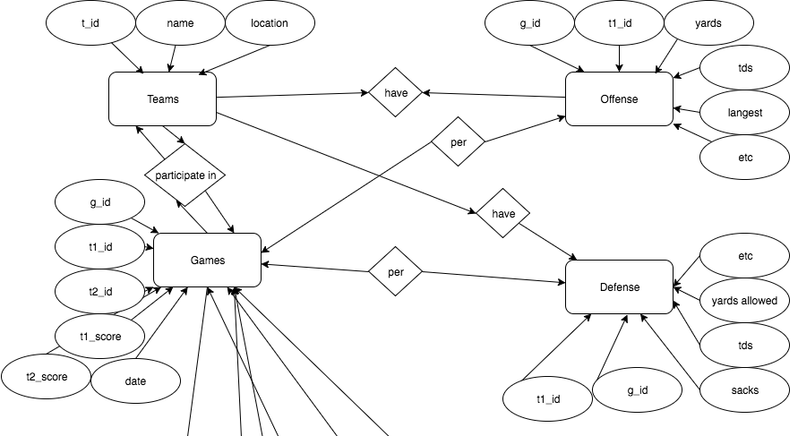
E-R Diagram
Teams
Games
Players
Offense
Receiving
Passing
Rushing
Defense
Preturns
Kicking

Slide 5
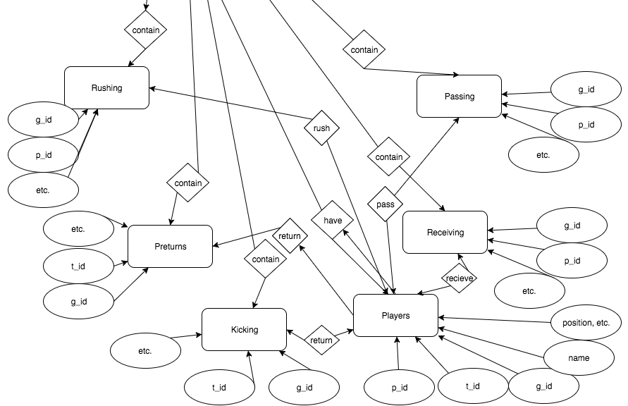

Slide 6
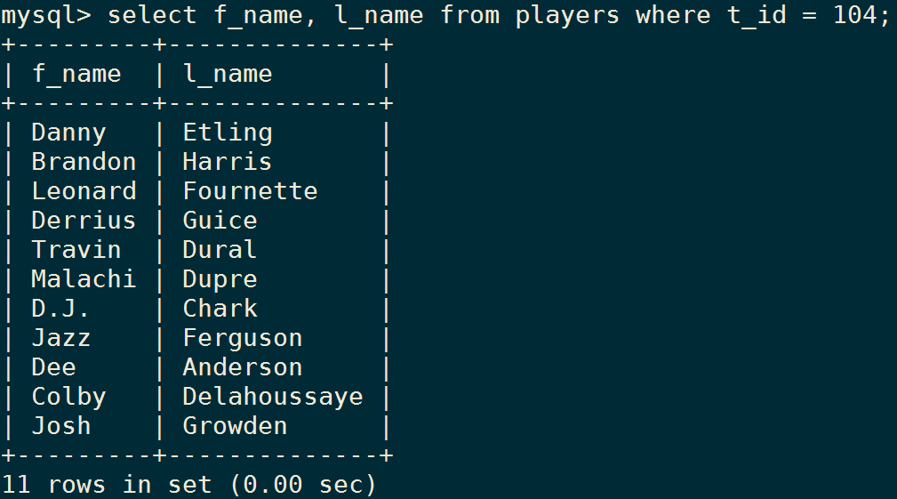
Database Demo
Show all the players from LSU.

Slide 7
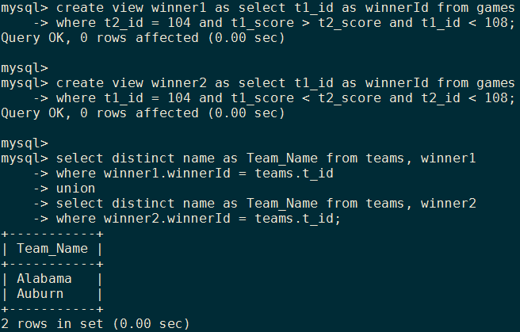
Database Demo
Show all the SEC West teams that LSU lost to.

Slide 8
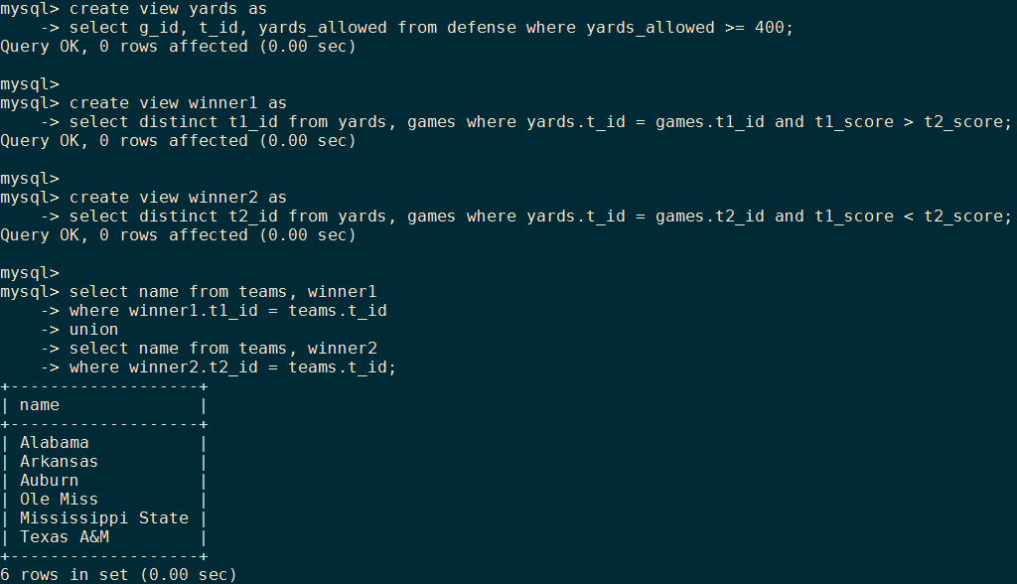
Database Demo
Show the teams that have won a game while giving up over 400 yards on defense.

